Slide 1
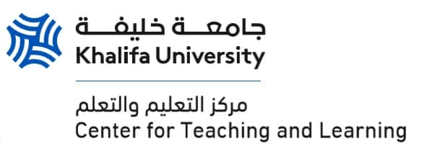
Upholding Academic Integrity
Strategies for Exam Invigilation

Slide 2
General Proctoring Instructions
Familiarize yourself with all KU exam-related policies, including those on academic integrity, examinations, special needs, and the use of unauthorized device detectors.
1
Ensure Wi-Fi and Bluetooth signals are disabled in exam rooms during major assessments to prevent academic dishonesty.
2
Apply rules and guidelines uniformly and fairly to all students, focusing on rule violations rather than assumptions based on appearance or behavior.
3
Maintain a polite, respectful, and calm demeanor, addressing potential issues discreetly to avoid student embarrassment.
4
Encourage a positive atmosphere, support student success, and handle suspected violations with clear evidence and an open mind.
5

Slide 3
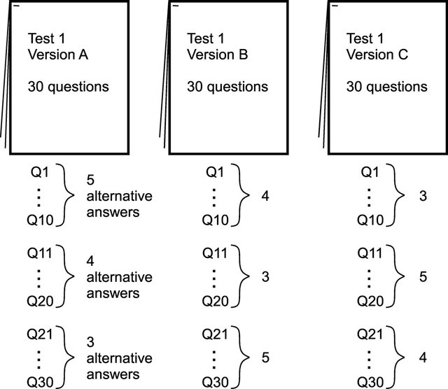
Shuffle questions, create multiple problem figures for versions, and alter assessments.
Vary question difficulty and avoid reusing old questions.
Do not discuss exam details with students or unauthorized personnel.
Share exams with colleagues only through encrypted or password-protected means.
Print your own exams and keep them secure.
Use the Restricted Printing Drive and collect printed exams from designated secured rooms.
Preparing The Assessments

Slide 4
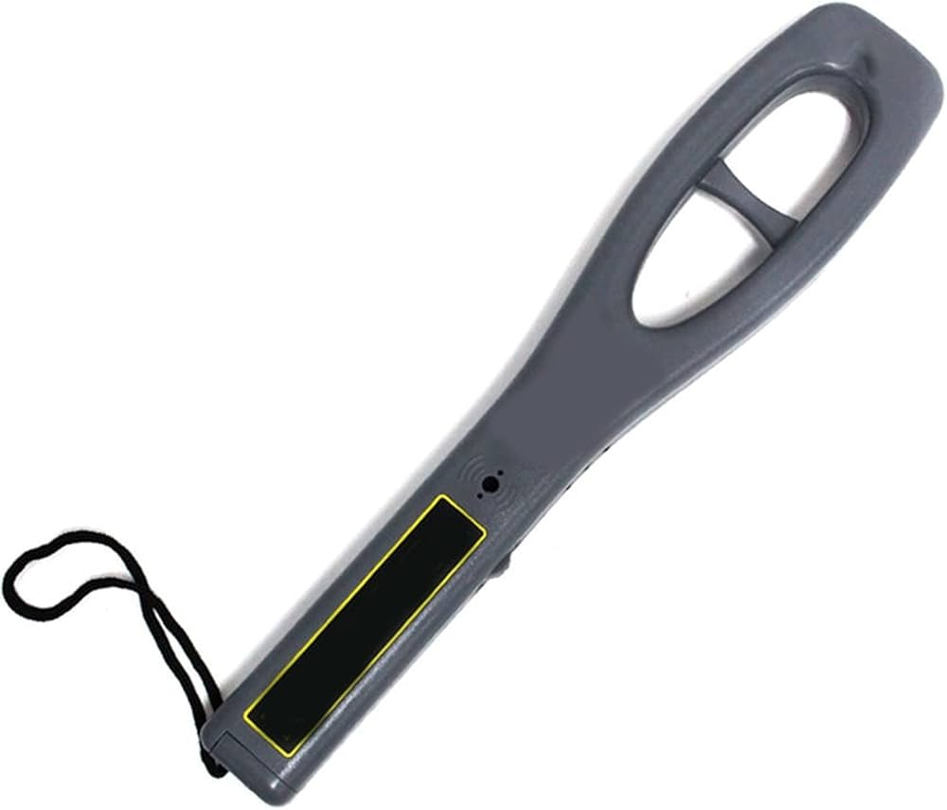
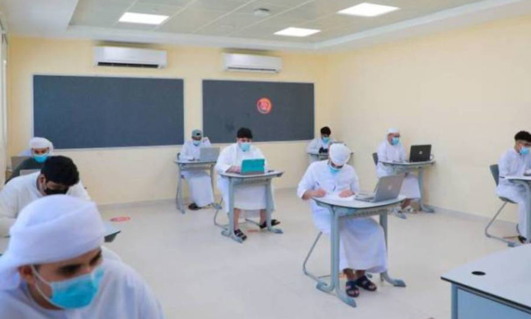
Before The Exam
Plan for invigilation with additional invigilators, lab staff, and TAs; accommodate students with individualized needs via Student Services.
Maintain a 1:20 invigilator-to-student ratio.
Arrive at the exam venue at least 15 minutes early and stay throughout the exam.
Remind students to leave electronic keychains and keys outside to prevent detector false positives.
Ensure each faculty member has a charged and maintained Unauthorized Device Detector; collect from the Department Administrative Assistant if needed.
Survey the exam room with the detector for background signals before students enter.
Conduct a thorough sweep with the detection device after students are seated and before distributing exam papers.

Slide 5
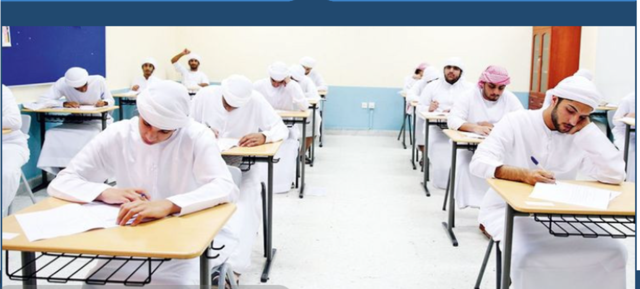
During the Exam
Take attendance, check IDs, and space out seating; deny entry if over 5 minutes late.
Read the honor pledge and remind students that electronic devices are prohibited.
Restrict unsupervised exits; collect exam papers if students leave and don't allow re-entry.
Prohibit borrowing items during the exam.
Invigilators should periodically monitor for unauthorized devices with detection devices.
Proctors should avoid using electronic devices unless urgently needed for the exam.
Coordinate invigilators to cover the classroom and scan for unauthorized devices.
Keep detection devices on vibration mode to minimize disruptions.
Use detection devices only on KU premises for official duties.

Slide 6
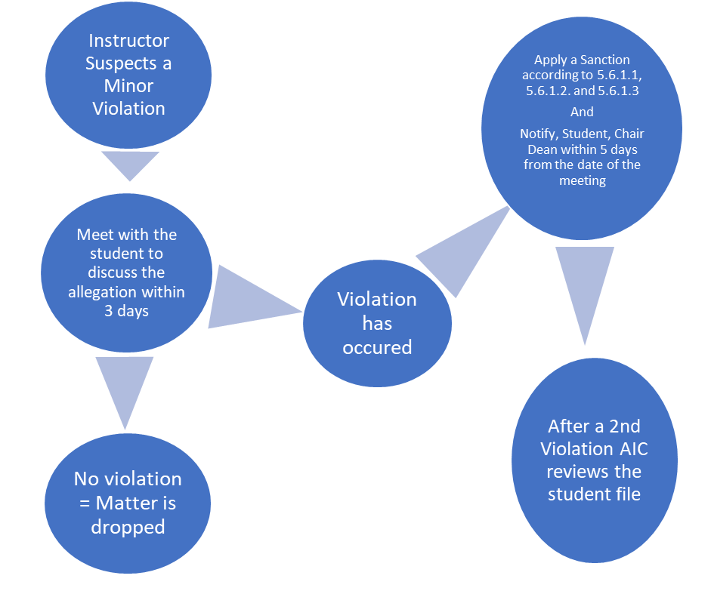
After the Exam: Procedure for Reporting Minor Violations
Notes:
This information was retrieved from: https://webparent.ku.ac.ae/pp/Images/ACA_3500_Academic_Integrity.pdf

Slide 7
Procedure for Reporting Major Violations
Instructor Suspects a Major Violation
Meet with the student to discuss the allegation within 3 days
No violation = Matter is dropped
Violation has occured
Notify, Student, Chair Dean in writing within 5 days from the date of the meeting
And
The student file is sent to the judicial officer to gather evidence and send it to AIC
AIC hold a meeting, interviews, instructor, student separately
AIC Communicates sanctions, if any, with provost and notifies RO of the outcome(s)
RO communicates Final Decision to the Student, Instructor, Chair, and Dean
Notes:
This information was retrieved from: https://webparent.ku.ac.ae/pp/Images/ACA_3500_Academic_Integrity.pdf

